Slide 1
8255 Programmable I/O Port

Slide 2
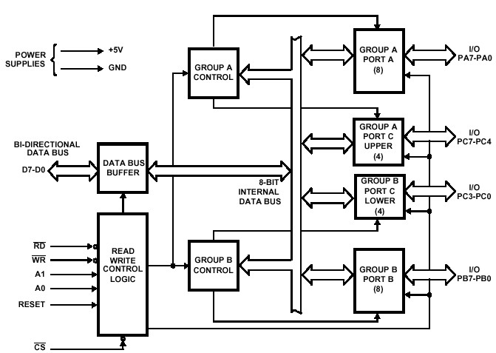
Functional block diagram of 8255 PPI

Slide 3
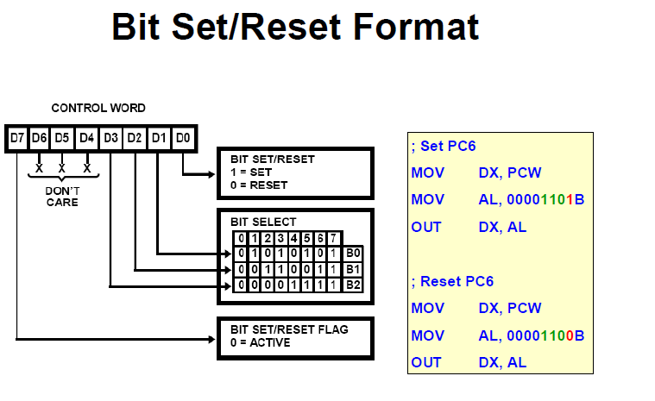

Slide 4
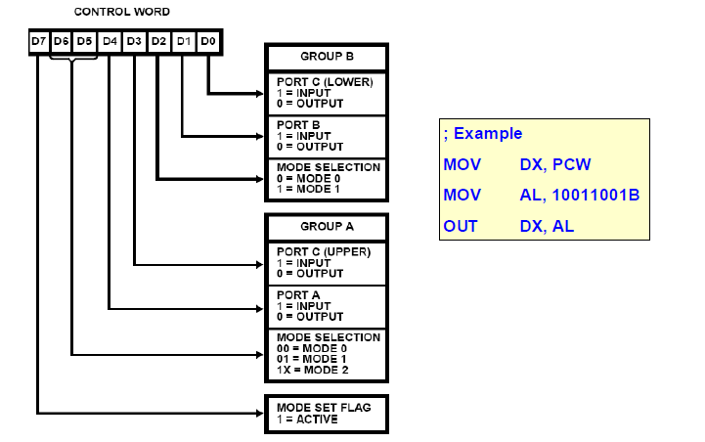
I/O Mode Format

Slide 5

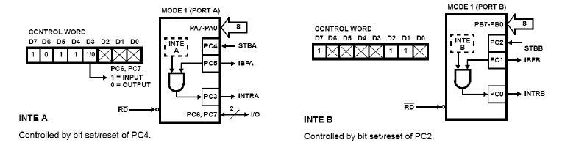

Slide 6
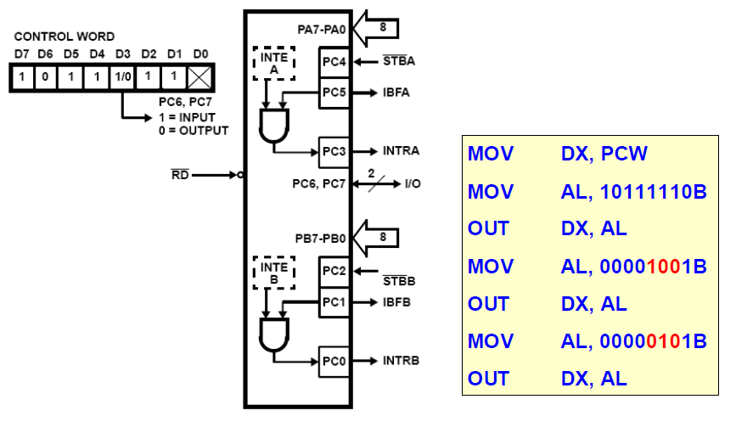

Slide 7
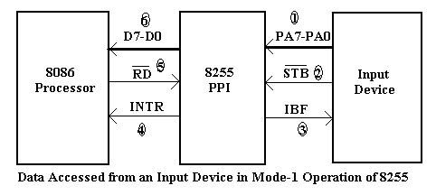

Slide 8
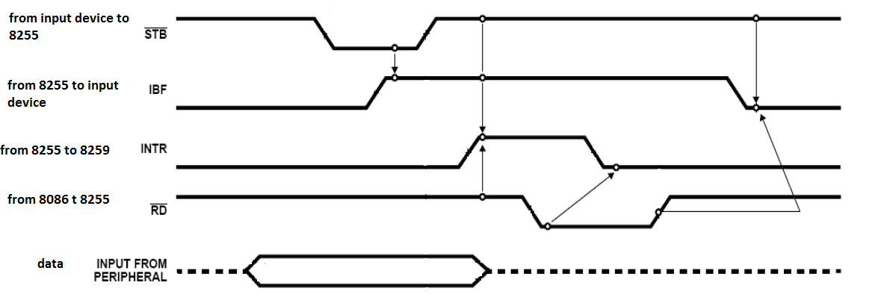
Timing waveforms for 8255 handshake data input from a input device

Slide 9

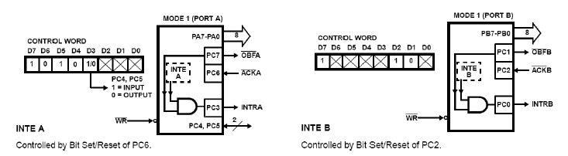

Slide 10
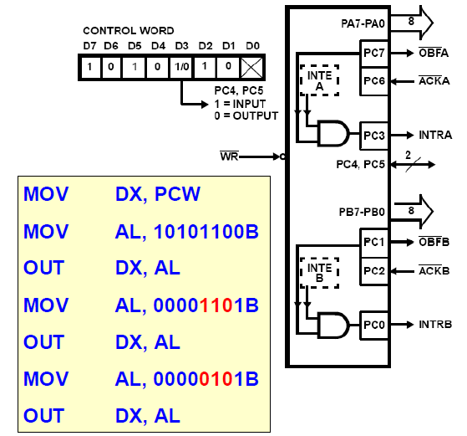

Slide 11
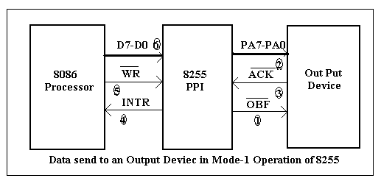

Slide 12
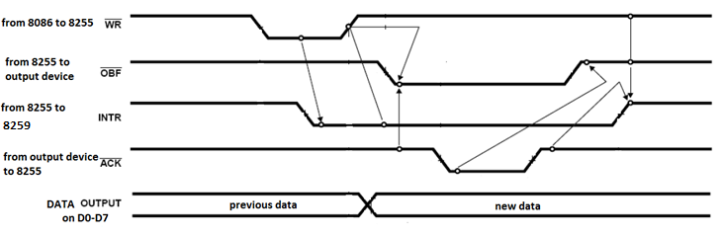
Timing waveforms for 8255 handshake data output to a output device

Slide 13

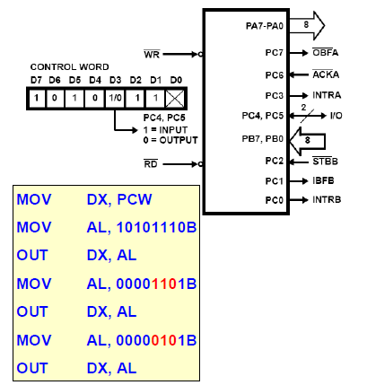

Slide 14
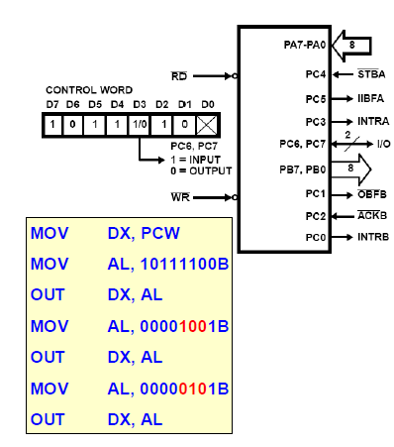

Slide 15
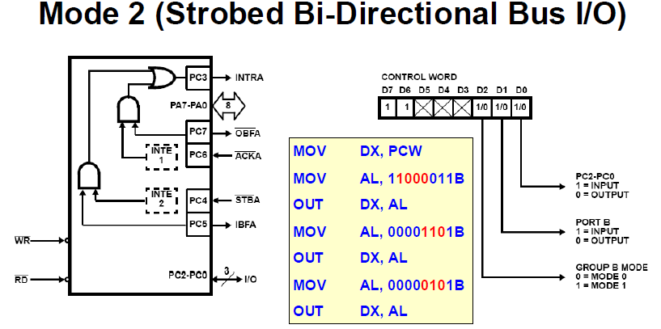

Slide 16
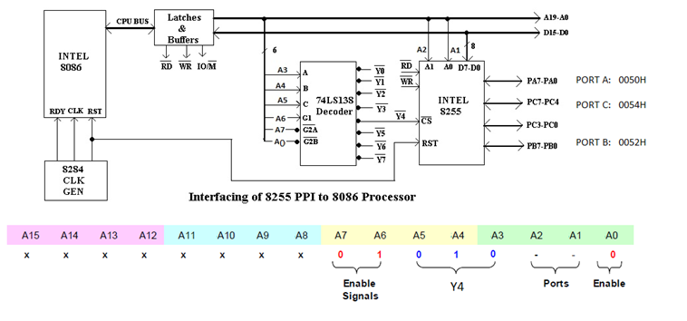
Interfacing of 8255 PPI to 8086 Microprocessor

Slide 17
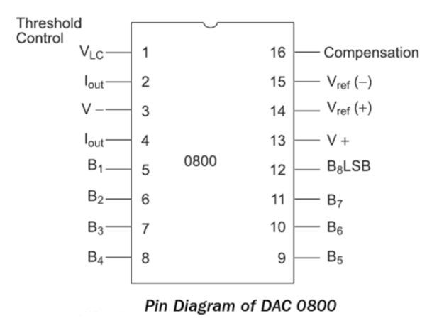

Slide 18
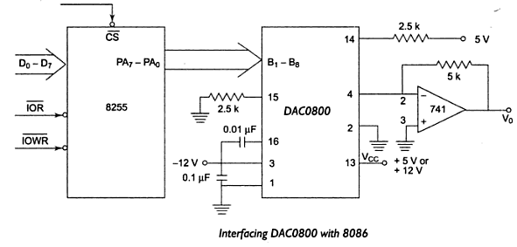
DAC Interfacing

Slide 19
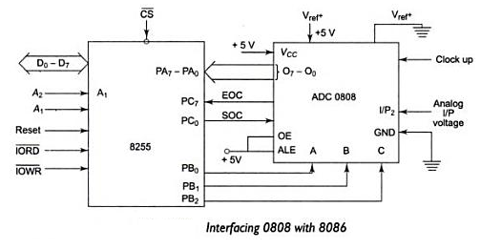
ADC Interfacing

Slide 20
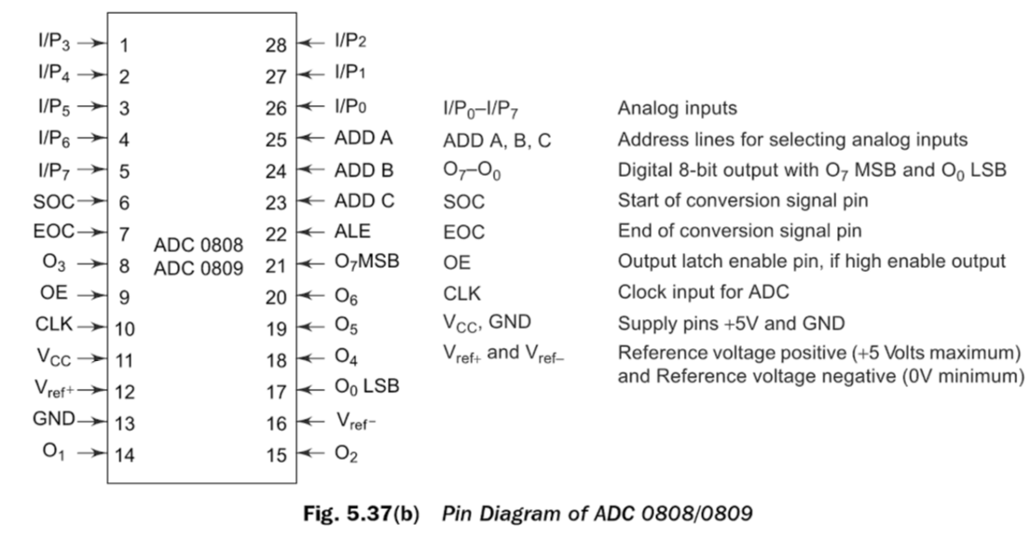

Slide 21
8259
PROGRAMMABLE INTERRUPT CONTROLLER

Slide 22
Methods to Service an I/O Device
Programmed I/O (Polling)
Interrupt Driven I/O

Slide 23
Programmed I/O
Programmed I/O method is the first method used tocheck whether an I/O device needs a service.
Programmed I/O checks the status of I/O interface periodically under the control of the software.
It is appropriate for small systems and dedicated applications with limited number of I/O devices.
The drawbacks of programmed I/O:
It wastes the CPU time in busy wait loops.
It is difficult to implement prioritized service.
It worsens the response time of a CPU to respond to a request.

Slide 24
Interrupt Driven I/O
Unlike the polling technique, interrupt processing allows the microprocessor to execute other software.
As soon as the microprocessor gets an interrupt from I/O interface, it stops executing the running program and starts the execution of the Interrupt Service Routine (ISR) to service the I/O device.
When the microprocessor finishes the execution of ISR, it returns to the interrupted program.
The advantages of the interrupt driven I/O method:
It increases the CPU throughput since the microprocessor does not waste its time in the busy wait loop.
It is easy to implement prioritized service.
It improves the response time.

Slide 25
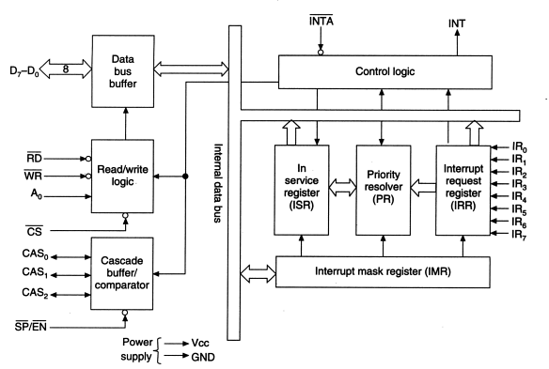
Block Diagram of 8259 PIC

Slide 26
CONTROL/COMMAND WORDS OF 8259
The 8259A accepts two types of command words generated by the CPU:
Initialization Command Words (ICWs):Before normal operation can begin, each 8259A in the system must be brought to a starting point—by a sequence of 2 to 4 bytes timed by pulses.
Operation Command Words (OCWs): These are the command words which command the 8259A to operate in various interrupt modes. These modes are:
Fully nested mode
Rotating priority mode
Special mask mode
Polled mode
The OCWs can be written into the 8259A anytime after initialization.

Slide 27
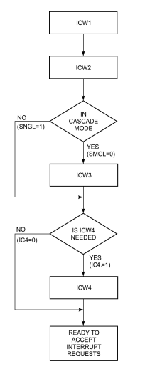
Flowchart of Initialization sequence of 8259 PIC

Slide 28
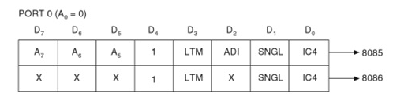
ICW 1

Slide 29
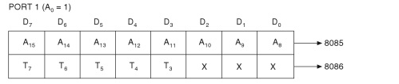
ICW2

Slide 30
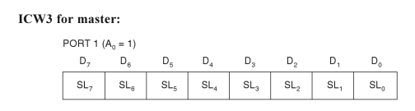
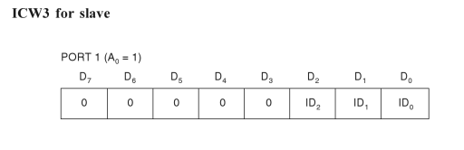
ICW3

Slide 31

ICW4

Slide 32
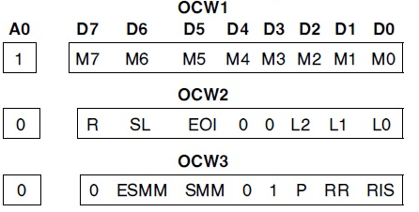
Operation Command Words:

Slide 33

Operation Command Word 1 (OCW 1)
M₇—M₀ represent the eight mask bits for the IR₇-IR₀ interrupt request levels.
M = 1 indicates Interrupt Request (IR) input is masked or disabled.
M = 0 indicates Interrupt Request (IR) input is unmasked or enabled.

Slide 34
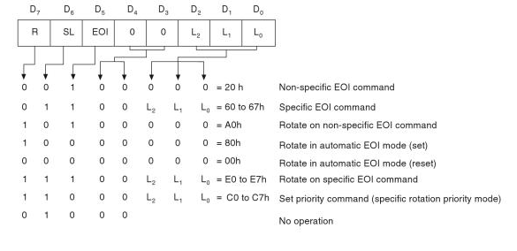
Operation Command Word 2 (OCW 2)

Slide 35
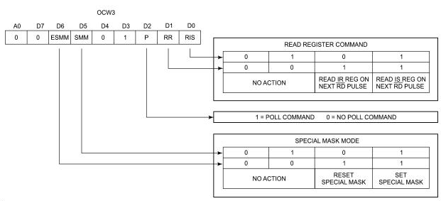
Operation Command Word 3 (OCW3)

Slide 36
8251 USART

Slide 37
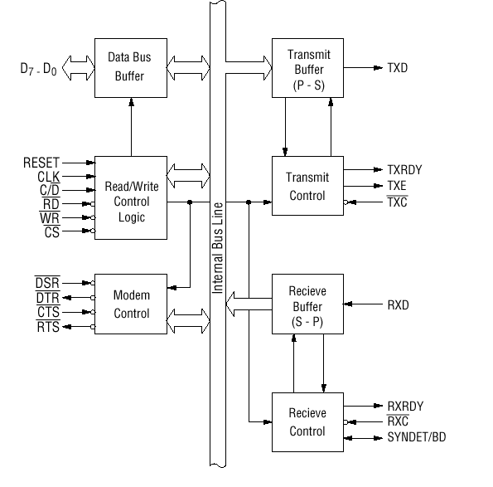
8251 UNIVERSAL SYNCHRONOUS ASYNCHRONOUS RECEIVER TRANSMITTER (USART)

Slide 38
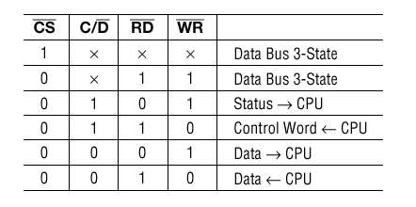
Summary of control signals for the 8251

Slide 39
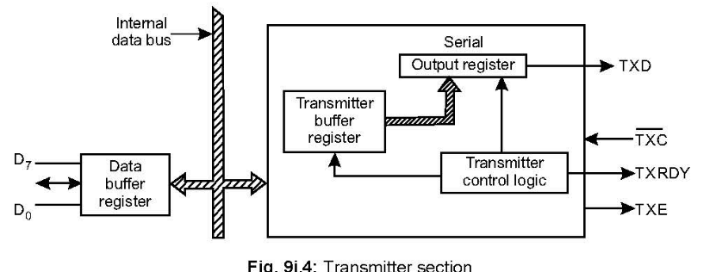
Transmitter section of 8251

Slide 40
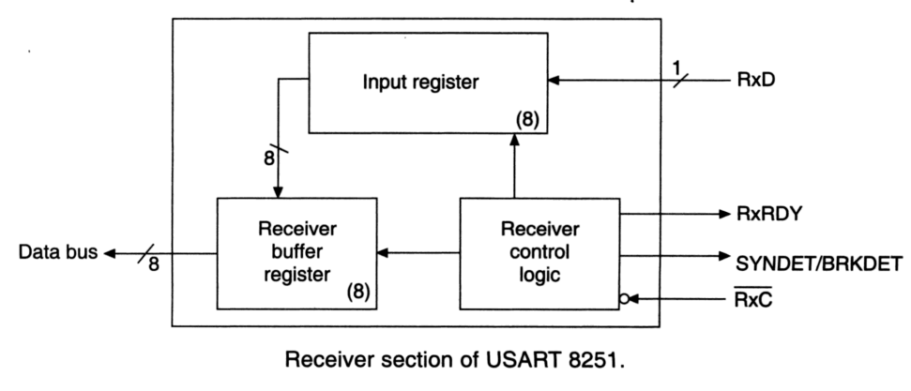
Receiver section of 8251

Slide 41
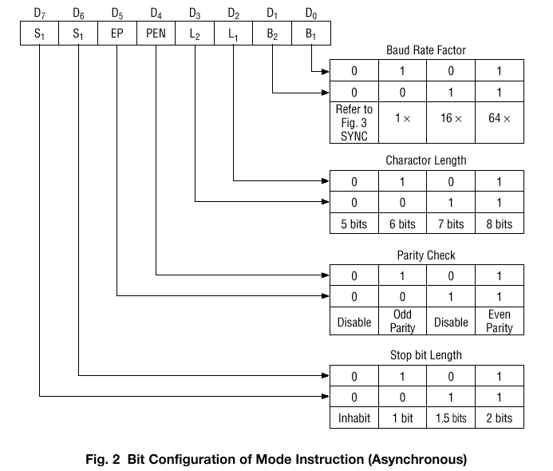
Mode instruction format for Asynchronous

Slide 42
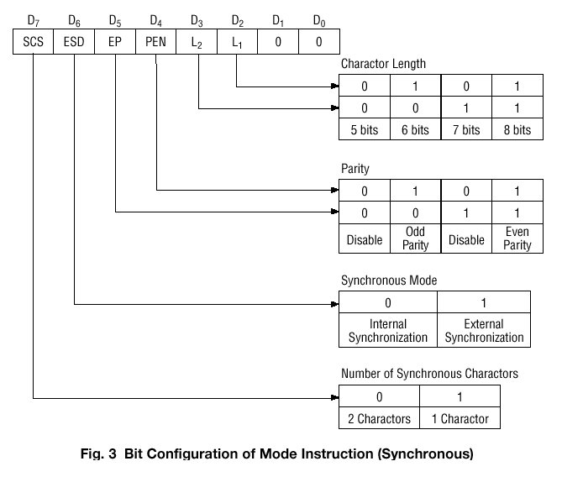

Slide 43
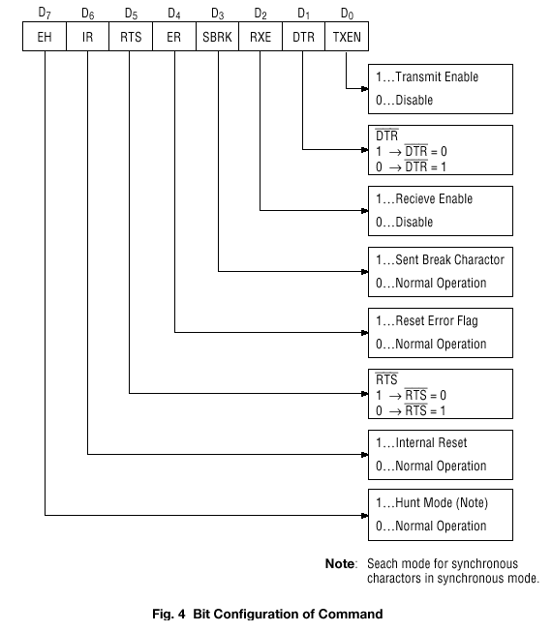

Slide 44
